Slide 1
超越学科界限的认知基础 Transdisciplinary Cognitive Foundation Namespace Management Week 2
Ben Koo
September 21, 2020

Slide 2
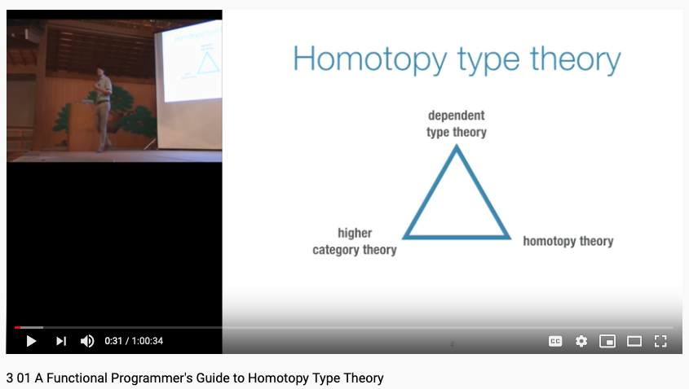
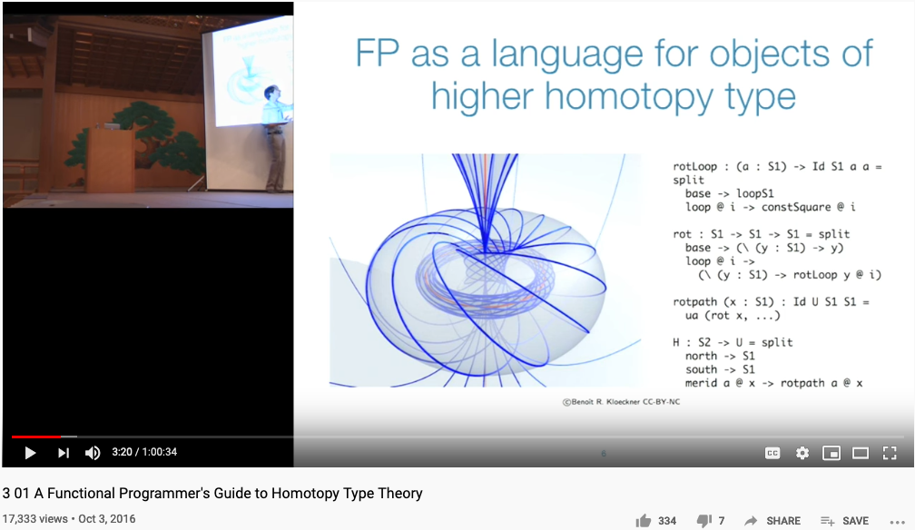
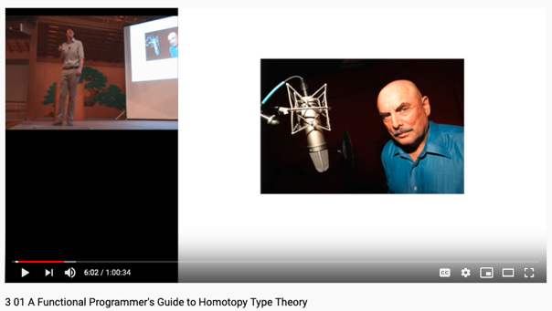
This is not just a SOUND TEST, it is also a story about Data in a world where …
Don Lafontaine
A transdisciplinary foundation in math and programming by Prof. Dan Licata, Wesleyan University

Slide 3
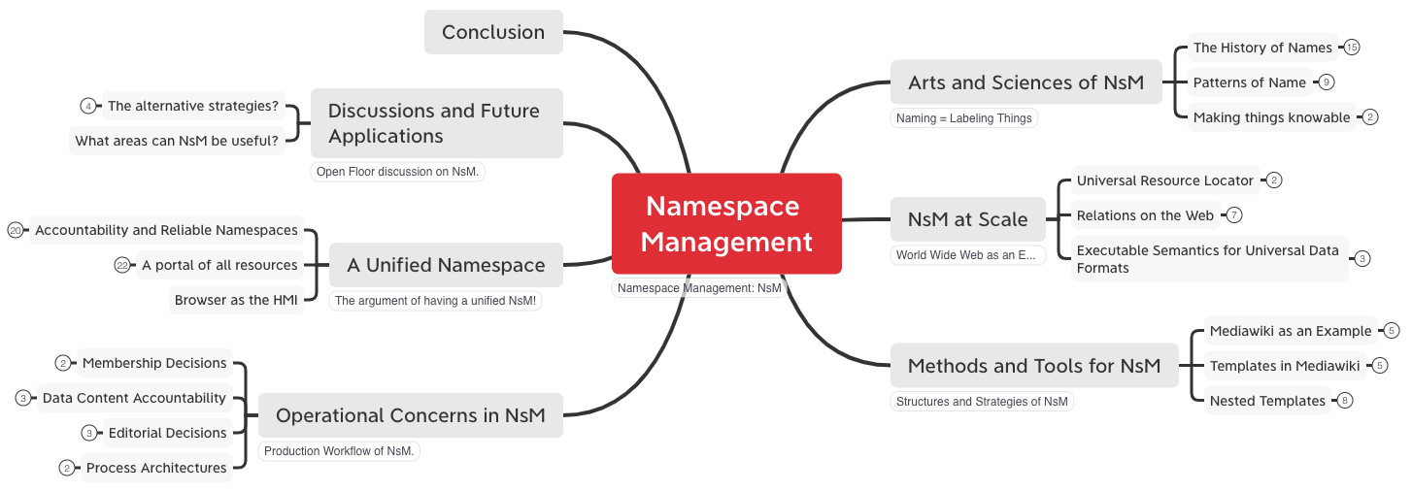
Lecture Outline

Slide 4
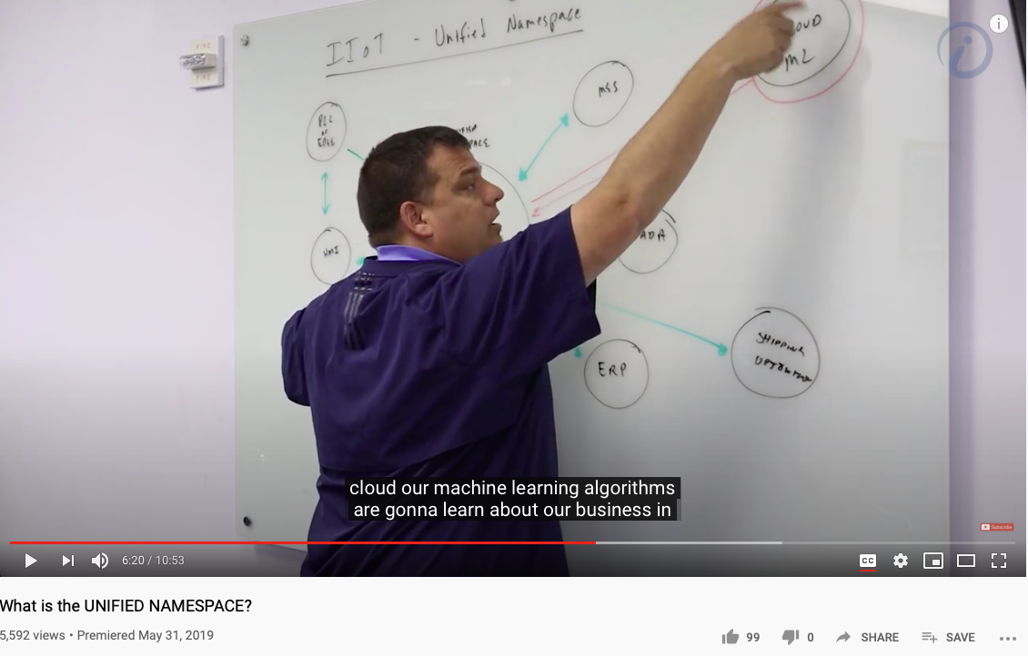
Unified Namespace
Huawei VP Mr. Yang Shaoqing
RICH 70 Tsinghua SEA Cloud Forum, Sep 14, 2020
H. E. Bambang Brodjonegoro,
Minister of Research & Technology, Indonesia

Slide 5
Arts and Sciences of NsM
History of Names
Patterns of Names
Trust-worthy Names
Namespace management is the Cognitive Foundation.

Slide 6


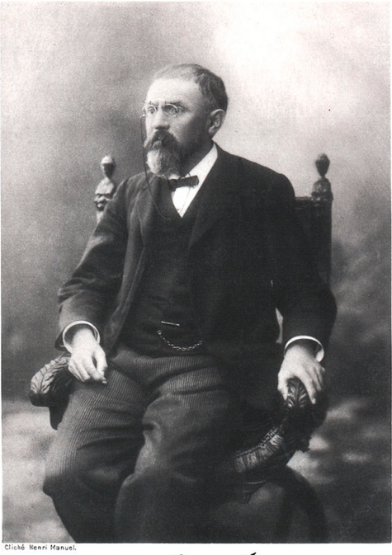
“Mathematics is the art of giving the same name to different things!” - Henry Poincare

Slide 7

NsM at Scale!
Objectives
A statement of a broad goal,
Usually qualitative in nature.
Key Results
A statement that measures
Achievement of a given objective

Slide 8


Methods and Tools
Time and Trust-worthiness
MediaWiki as a Tool
Data in MediaWiki/Wikipedia
Templates and Categories
Structures and Strategies in Namespace Management

Slide 9
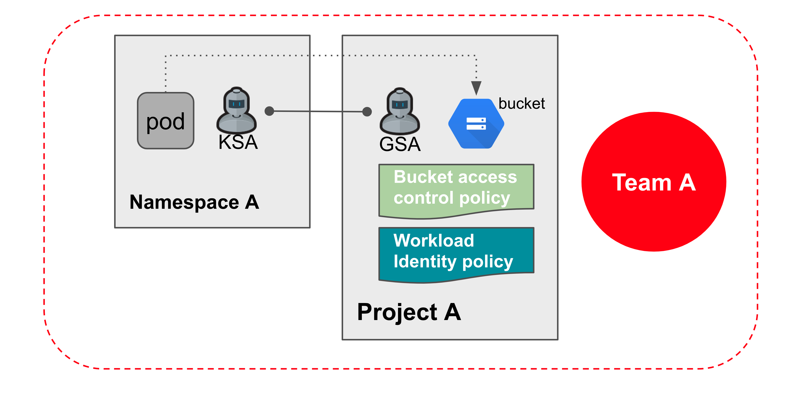
Operational Concerns
Access Rights
Editorial Decisions
Process Management
Image source: https://www.keeprunning.io/2019/09/24/workload-identity-config-connector/
Production Workflow of
Namespace Management

Slide 10
A Unified Namespace
What are representables?
Accountability and Reliability
A Portal to all Names
Browser as the Interface
Objectives
A statement of a broad goal,
Usually qualitative in nature.

Slide 11

Discussion and Future Applications
Objectives
A statement of a broad goal,
Usually qualitative in nature.
Key Results
A statement that measures
Achievement of a given objective

Slide 12
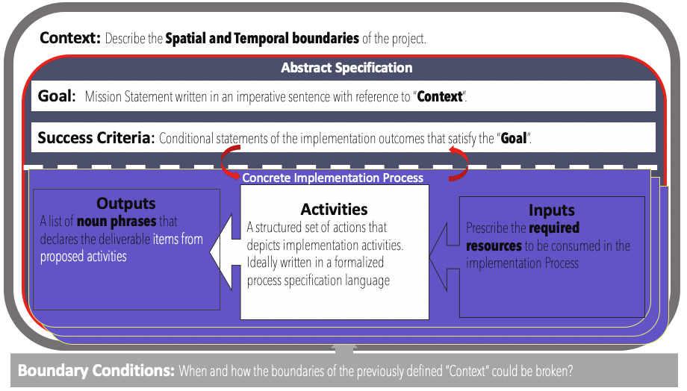
Logic Model (OKRs) as a Transdisciplinary Foundation

Slide 13
Objective & Key Results (OKRs)
Objectives
A statement of a broad goal,
Usually qualitative in nature.
Key Results
A statement that measures
Achievement of a given objective

Slide 14



Reference Materials on OKRs

Slide 15
Context: Describe the Spatial and Temporal boundaries of the project.
Contextualized Objectives
Goal: Mission Statement written in an imperative sentence with reference to “Context”.
Success Criteria: Conditional statements of the implementation outcomes that satisfy the “Goal”.
Concrete Implementation Process
Process that Delivers Key Results
Outputs
A list of noun phrases that declares the deliverable items from proposed activities
Activities
A structured set of actions that depicts implementation activities.
Ideally written in a formalized process specification language
Outputs
A list of noun phrases that declares the deliverable items from proposed activities
Activities
A structured set of actions that depicts implementation activities.
Ideally written in a formalized process specification language
Inputs
Prescribe the required resources to be consumed in the implementation Process
Inputs
Prescribe the required resources to be consumed in the implementation Process
Boundary Conditions: When and how the boundaries of the previously defined ”Context” could be broken?

Slide 16


Context: Modern Technologies challenges the cognitive capacities of human and human societies.
Goal: Provide a methodical cognitive framework to leverage contemporary technologies and cognitive science content.
Success Criteria: Enable students to utilize cognitive methods and tools, while measuring learning outcomes accordingly.
Outputs
Cognitive Science Report
Summarize your methods
Digitally published Learning Reports
Behavioral Data (on MediaWiki)
Personally chosen application areas
Biology, Physics, Math, Literature, Social Science, Arts, …
Activated Processes
1. Course Preparation
Content and Process design
2. Learning Program Execution
16 week exercise
3. Program Refinement
Continuous Adjustments
Periodic Refinements
Inputs
Curricular Structure
Coherent with university-level curriculum design
Content Data
A time-oriented knowledge(data) representation framework
Meta Data Formats
Logic Model(OKRS), Learning Report Format, Universal Resource Locators
Boundary Conditions: Personal willingness to adopt a new cognitive foundation, and intensity of practicing this new skill

Slide 17

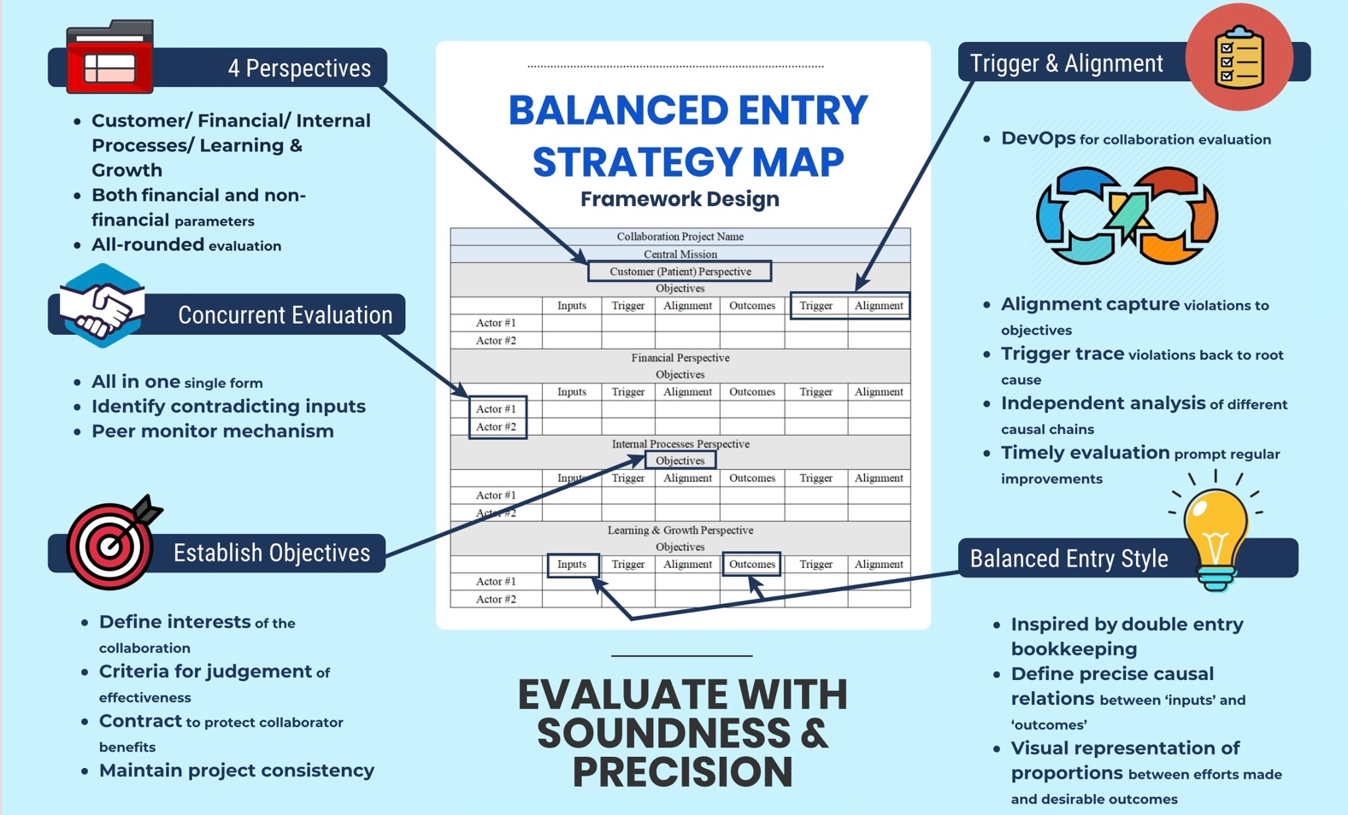
Introduce Balanced Strategy Map (BSM) by Kristy Wong A new kind of Logic Model & a variant of OKRs (Spring 2020)

Slide 18


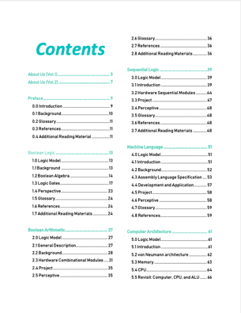
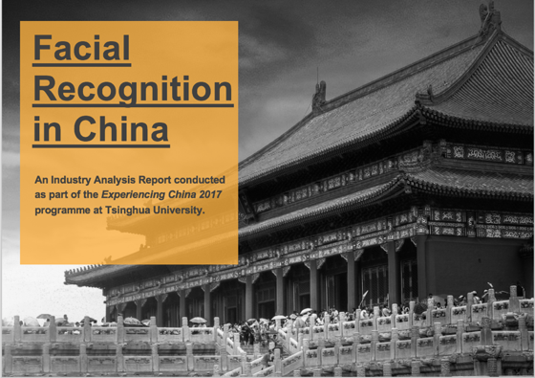

A course that invite you to investigate THINKING at multiple scales create and publish your own ideas in a digital publishing workflow…

Slide 19



2018 International Summer Program @ Tsinghua Experience a publishing workflow using DevOps

Slide 20
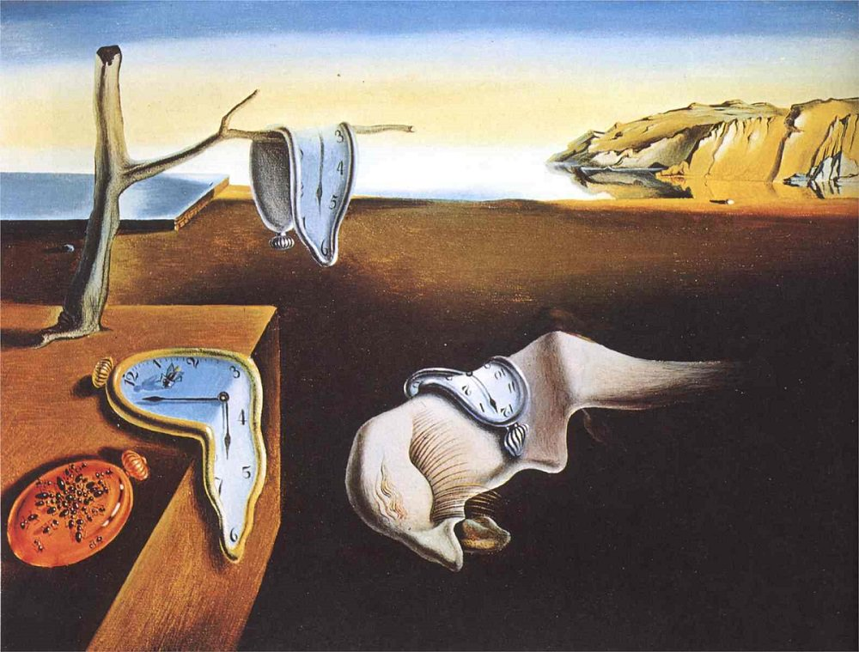
CONTEXT that Narrows your scope of Objectives
GLOBALIZATION AND INDUSTRIALIZATION CHALLENGED THE BOUNDARY OF HUMAN COGNITIVE POWERS
THE SPEED OF CHANGES EXCEEDS MENTAL CAPACITY
Societal Implosion & Globalized Chaos
Incoherent minds and body
overwhelmed by new knowledge
lost of self-worth

Slide 21
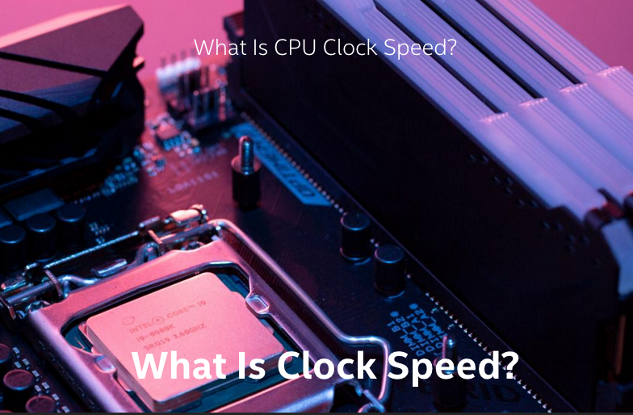


Clockspeed of society is increasing all the time

Slide 22
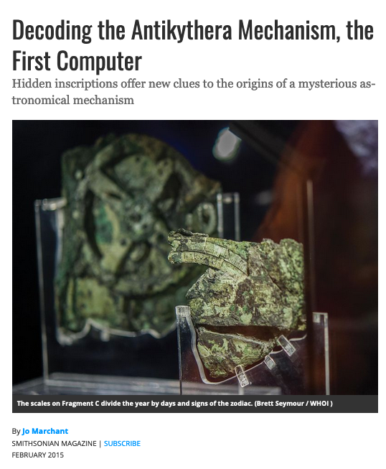

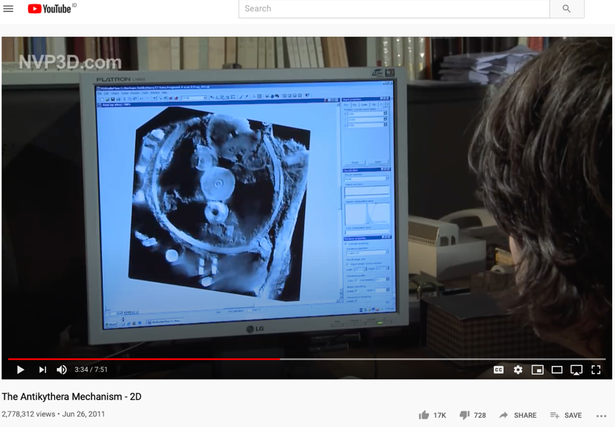
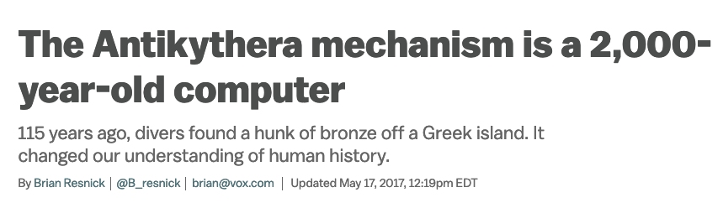
Speed is the Dominant factor in Decision Making
A NEW Cognitive Foundation is needed to enable
Sufficiently FAST
collective learning!

Slide 23
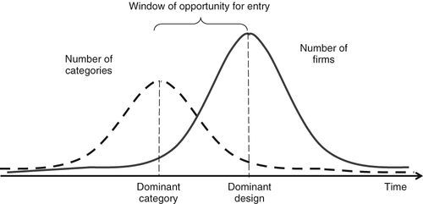
Power of a Dominant Design/Protocol
“Theoretical framework: dominant category and dominant design during the industry life cycle. During the industry life cycle, the number of categories will increase before the number of firms increases. The emergence of the dominant category occurs as the number of categories begins to decrease. This point in time marks the opening of the window of opportunity for entry, whereas the emergence of the dominant design marks the closing of the window of opportunity”
Excerpt from the article:
Perfect timing? Dominant category, dominant design, and the window of opportunity for firm entry

Slide 24
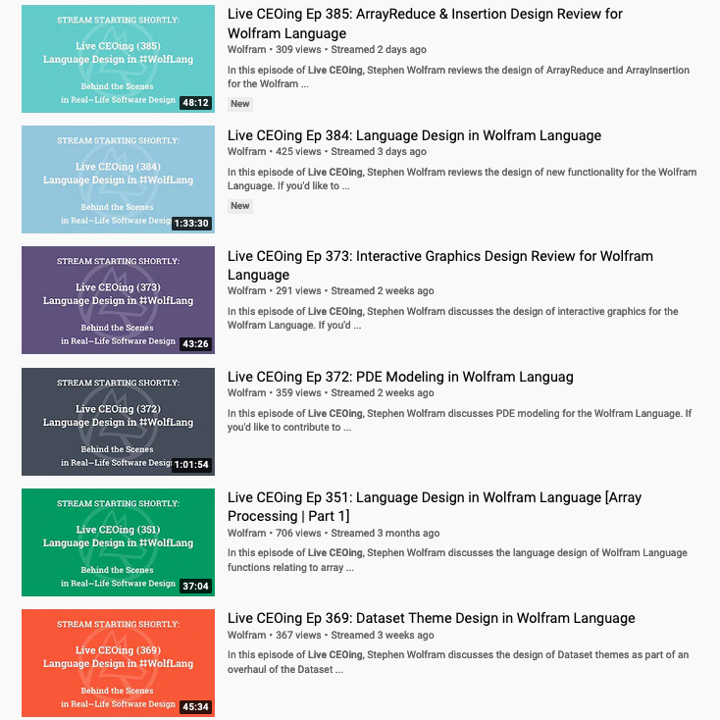
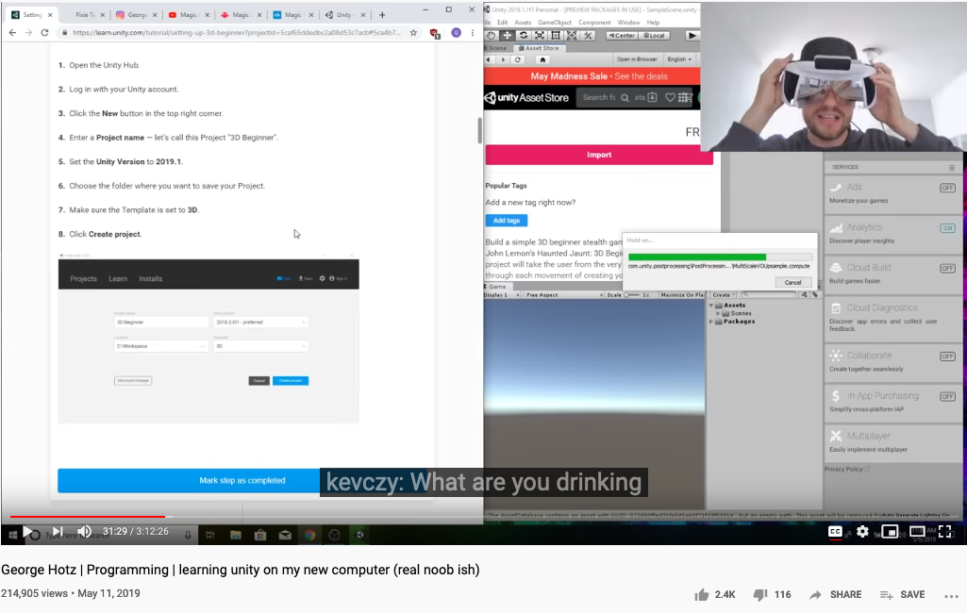
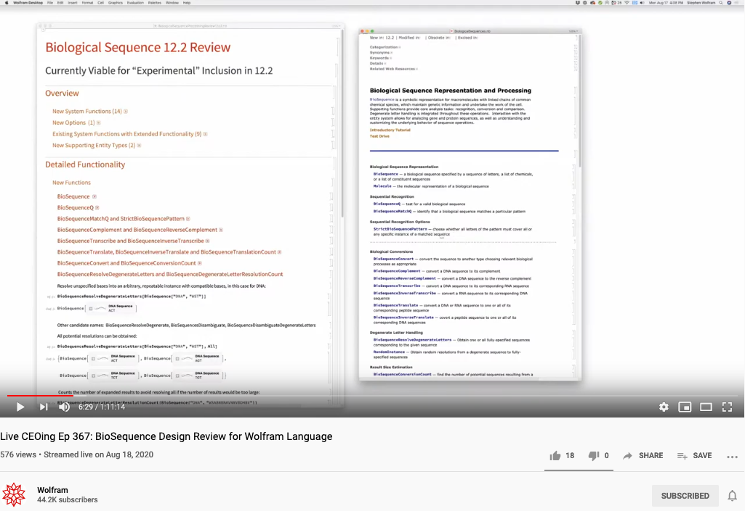
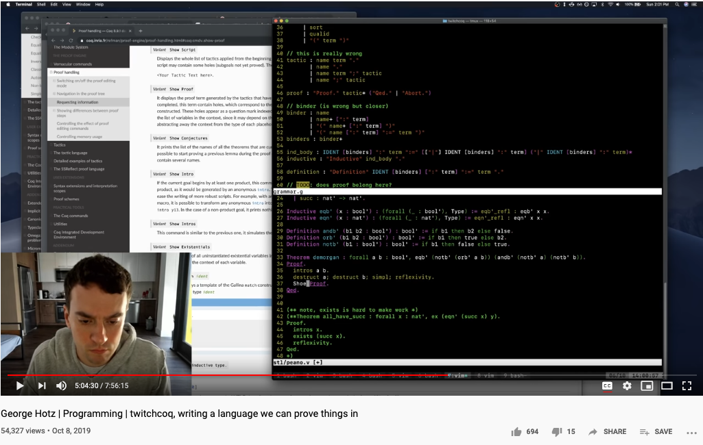

The World has changed … Ways to conduct business have changed …
https://en.wikipedia.org/wiki/George_Hotz

Slide 25


Kuhn Cycle: as the ticking clock
Normal Science
Model
Drift
Model Crisis
Model Revolution
Paradigm
Change
Emerging cases or
systematic attacks
Product Development Process
in five stages
Commit
Build
Test
Stage
Deploy

Slide 26
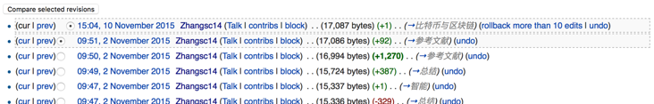

Three Scales of Time
Mesoscopic：
Localized Adjustments
Time Stamp
Macroscopic:
Five Stages of Evolution
Normal Science
(commit)
Model
Drift
(build)
Model Crisis
(test)
Model Revolution
(stage)
Paradigm Change
(deploy)
Microscopic：
Process Data and Summative Result
Time Stamp

Slide 27
Time Stamped Data Preserve Event Ordering Information
Normal Science
(commit)
Model
Drift
(build)
Model Crisis
(test)
Model Revolution
(stage)
Paradigm Change
(deploy)
Time Stamp
Time Stamp
Time Stamp
Time Stamp

Slide 28

Blockchain, Distributed Ledger Technologies: Time is Money
https://www.investopedia.com/terms/b/blockchain.asp

Slide 29






A Model of Collective Cognitive Processes
(students/teachers)
(Smart) Social Contract Execution
Traders
Miners
Coders
(Consumers/Distributors)
Three Asynchronous
Clocks in their respective
Communities
Version Upgrade
Production Code
Function Requests
Customer Crisis
Feature Revolution
Emerging cases or
systematic attacks
(Artists/Creative Projects)
(Administrators/Witnesses)
Perform Checking
receive confirmation
commit transaction
(Content Producers/Product Designers)
(Accountants/Lawyers)

Slide 30
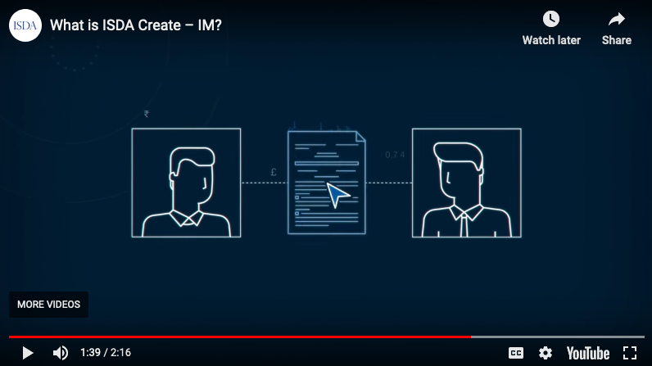
Smart Contract with Observable Historical Data
ISDA: International Swaps and Derivatives Association

Slide 31
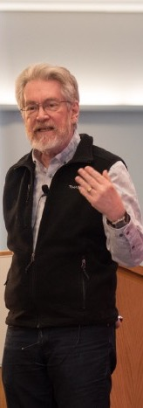


Legal Algorithms: Code is Law

Slide 32
Learning Process as a Publishing Workflow
Traders
（students/teachers）
Miners
（Administrators/Witnesses）
Coders
(Artists/Creative People)
(Consumers/Distributors)
(Content Producers/Product Designers)
(Accountants/Lawyers)

Slide 33

Learnability of a Multi-Scale DevOps Process
Traders
（students/teachers）
Miners
（Administrators/Witnesses）
Coders
(Artists/Creative People)
Sec
(Consumers/Distributors)
Dev
Ops
(Content Producers/Product Designers)
(Accountants/Lawyers)

Slide 34
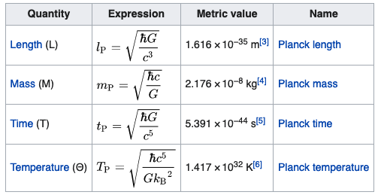


GOAL
Introduce students to a domain-independent cognitive science results according to the time-based linguistic framework.
Use of the Natural Units as the core linguistic elements
A Social Contract(OKRS) for Learner’s self governance
Create a knowledge container for everyone
Capture knowledge using a Mediawiki Database
Compile personal knowledge into a publication

Slide 35
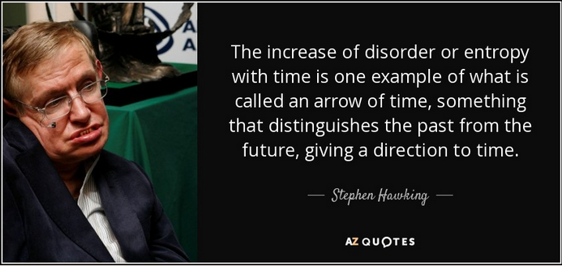
Success Criteria
Elevate Knowledge Orchestration Strategies up to the level of necessity presented by contemporary industrial complex
A foundational learning strategy that will continue to work as technologies progresses and complexity/entropy increases
A generally applicable metric (time) for knowledge content complexity
Self-adjusting as history evolves into the future

Slide 36
How to engage this Course?

Slide 37
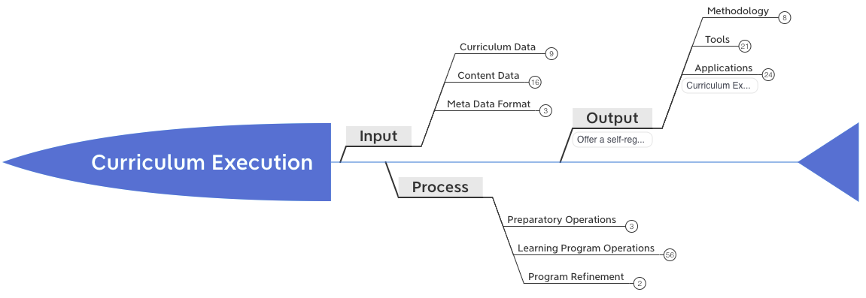
A Strategy to Stretch Cognitive Model
Enabled by modern Data Infrastructures, modern curriculum may
Be constructed by new Methods, Tools and Applications
Cognitive Model Extension

Slide 38
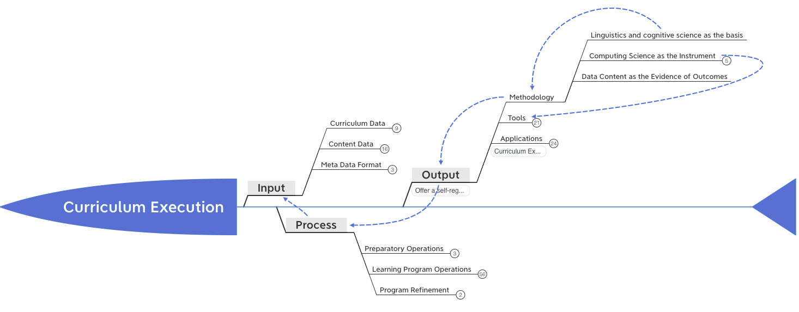
Driven by Linguistic/Cognitive Science
The Methods, Tools and Applications are based on
Linguistic/Cogntive and Computing Sciences
Cognitive Model Extension
“Mathematics is the art of given the same name to different things.”
― Henry Poincare

Slide 39
Time and Trust-worthiness in NsM
All Name Spaces should share a universal “clock”
The common “Historical-Trail” (time-based) of Name Spaces
So that the time-stamps would offer hints to cross-check “causal” consistency
Name Spaces should be extensible
It should follow one consistent naming convention for easy referencing
Kuhn’s Cycle provides a Generative/Cyclic Model
Name Space Authentication should be scalable and distributed
Existing mechanisms for authenticated name registration, i.e. Domain Name Services (DNS).

Slide 40
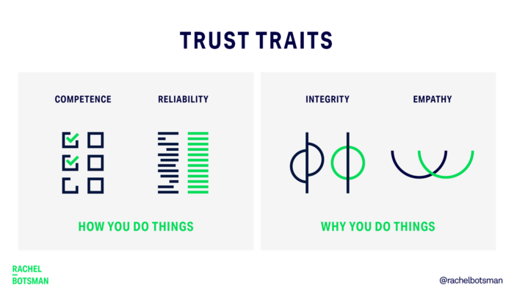
Trust-worthy Name Space?
Competence:
What can you deliver?
Reliability:
Success rate of delivery?
Integirty:
Will you ever cheat me?
Empathy:
Are you on my side?
Being More Trustworthy: The Basics
― Rachel Botsman, Jan 14, 2019

Slide 41
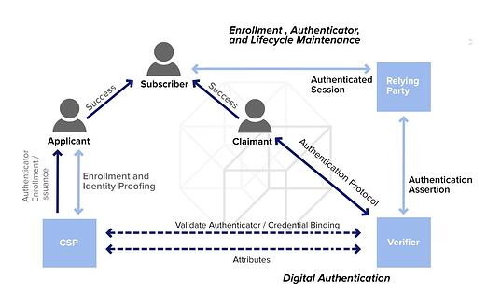
Authenticated Name Space?
Digital Authentication - the basics
― Dawn M. Turner (guest) on 01. August 2016

Slide 42
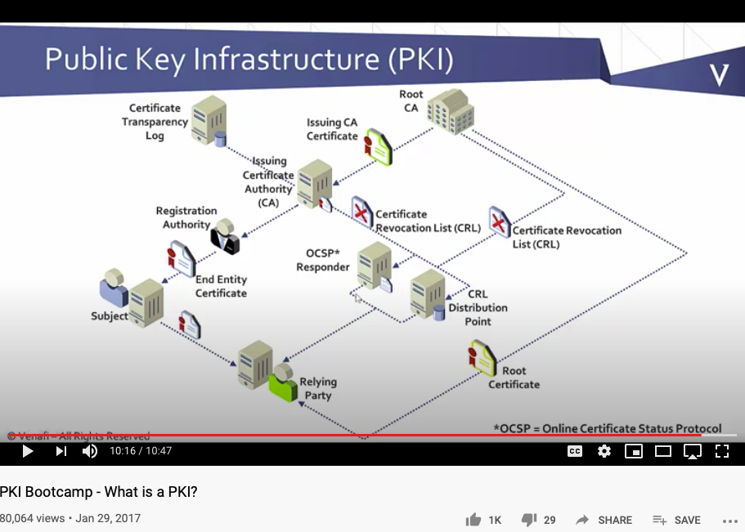
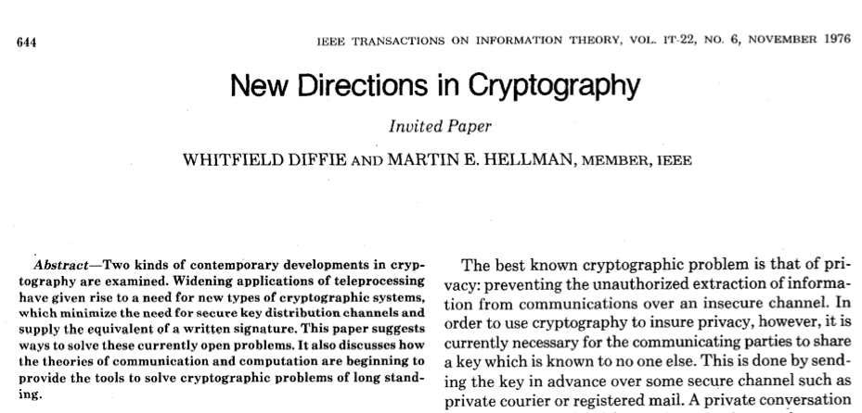
Public-Private Key NsM Infrastructures
The paper that changed
the direction of NsM!
What is Private Key Infrastructure?

Slide 43
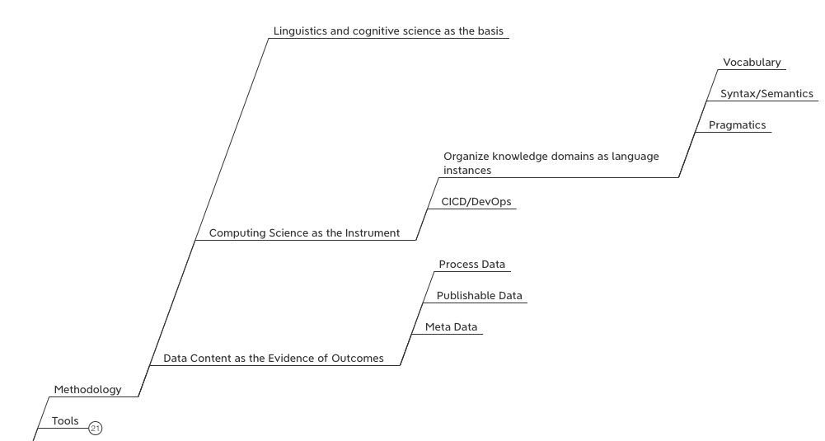
Representing Knowledge as Domain-Specific Languages (DSL)
Utilizing Computing Science to define
Vocabulary,
Syntactical Rules
Pragmatic Use Cases of the DSLs
Data Content is categorized in terms of
Process(Learner Behavior) Data,
Publishable Data (managed by participants)
Meta Data (formats or content index)

Slide 44

What is DevSecOps?
Sec
Dev
Ops
Image courtesy: Paladion Corporation Website https://www.paladion.net

Slide 45

Instrumentation of DevOps
Image courtesy: PETSEBAN on NearCoding

Slide 46
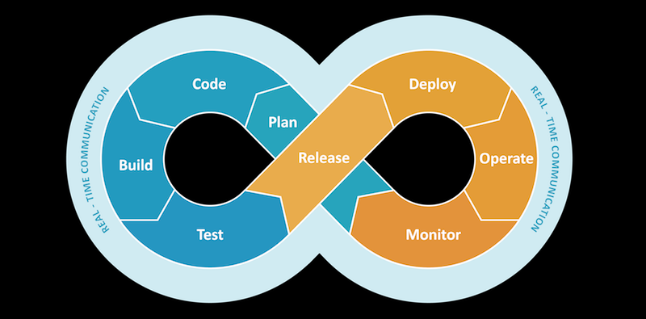
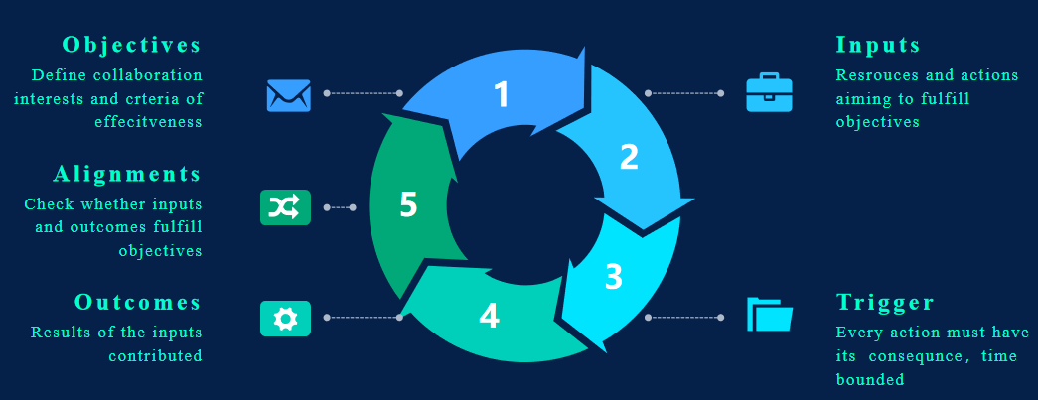
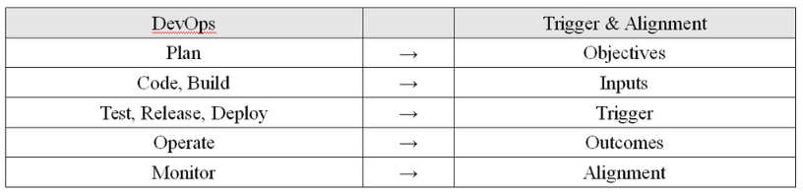
Trigger & Alignment in relation to DevOps
Notes:
The trigger section can track actions with specific consequences.The alignment section of the model monitors the quality of the inputs and outcomes captures conflict of interest when they failed to fulfill the objectives. When ‘caught violations’ are captured, evaluators could refer to the triggers and easily trace back to its root cause. The chain of inputs and outcomes involved can then be precisely extracted for further analysis.

Slide 47
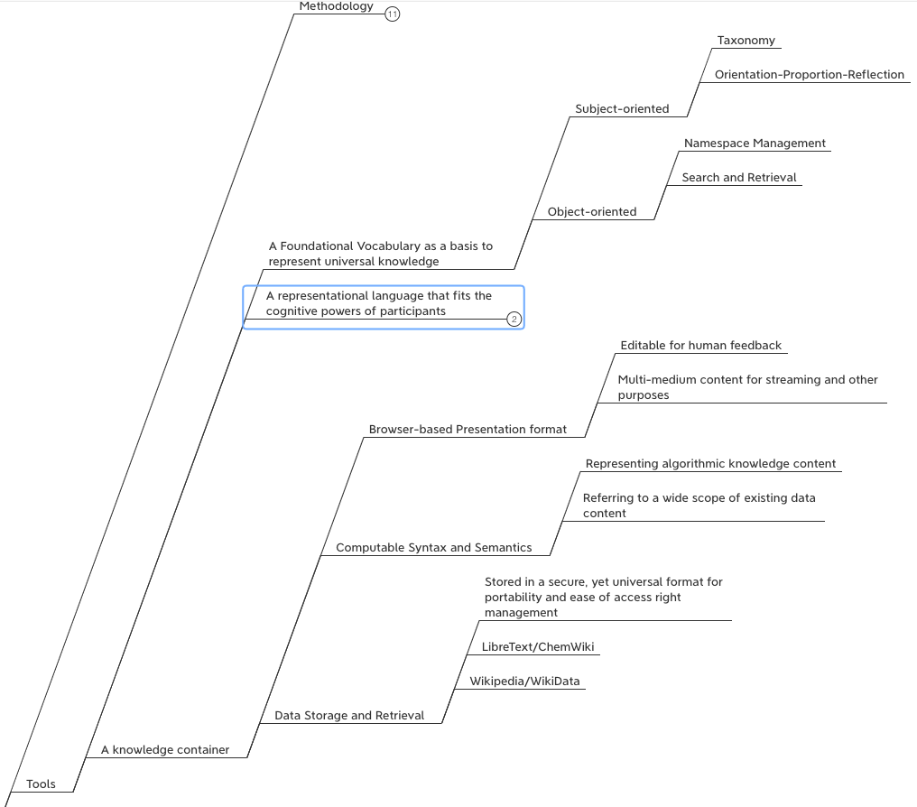






Abundant Tools and Data Sources for Large-Scale Knowledge Representation

Slide 48
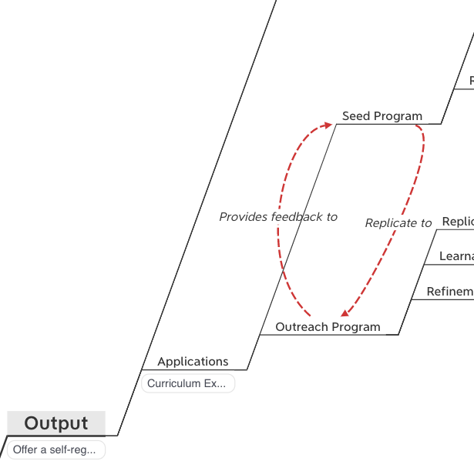
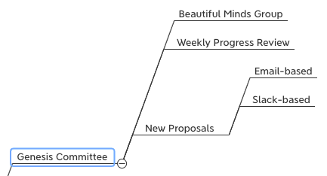
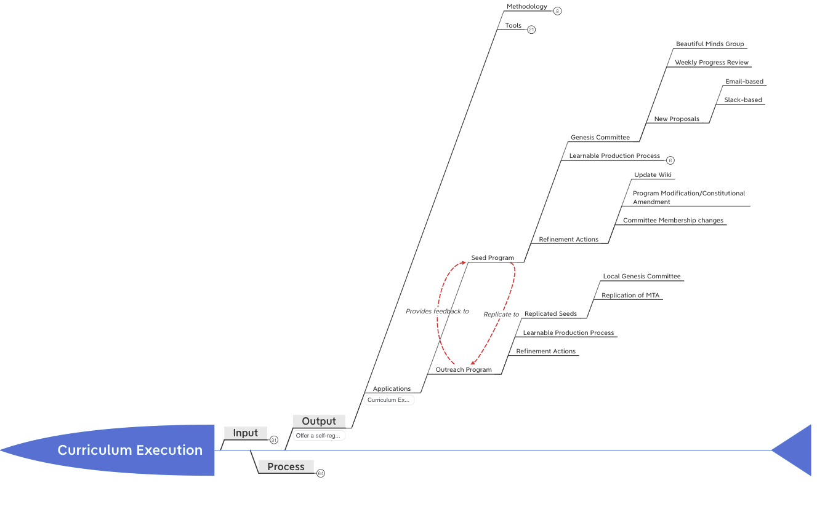
A Reflexive Program

Slide 49
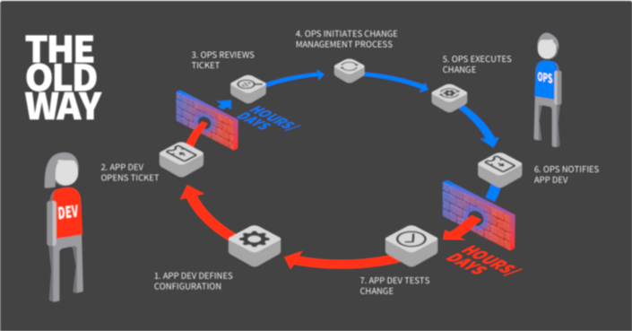


GitOps: Git as the Single Source of Truth

Slide 50
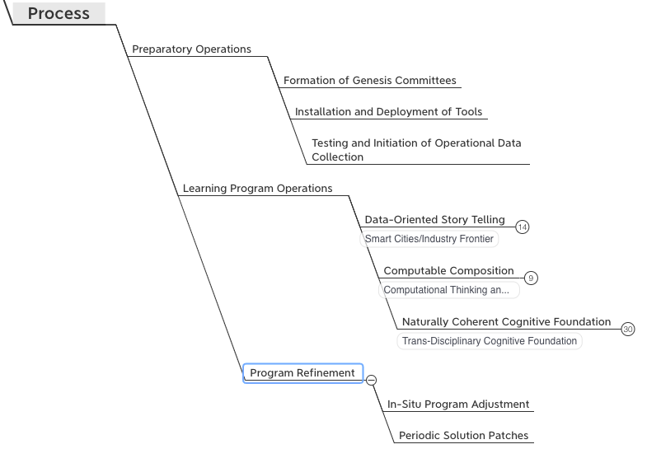
A Self-Optimizing Process
A common organizational template for
Learning organizations with tools and
Well-formed data structures
Broadly categorize courses into 3 types
Macro/Meso/Micro-scopic reasoning
All courses can find reusable elements
All programs should have two kinds of
Corrective/adjustment actions.
During/between program executions.

Slide 51
A Cognitive Learning Program that utilizes Contemporary Tools

Slide 52
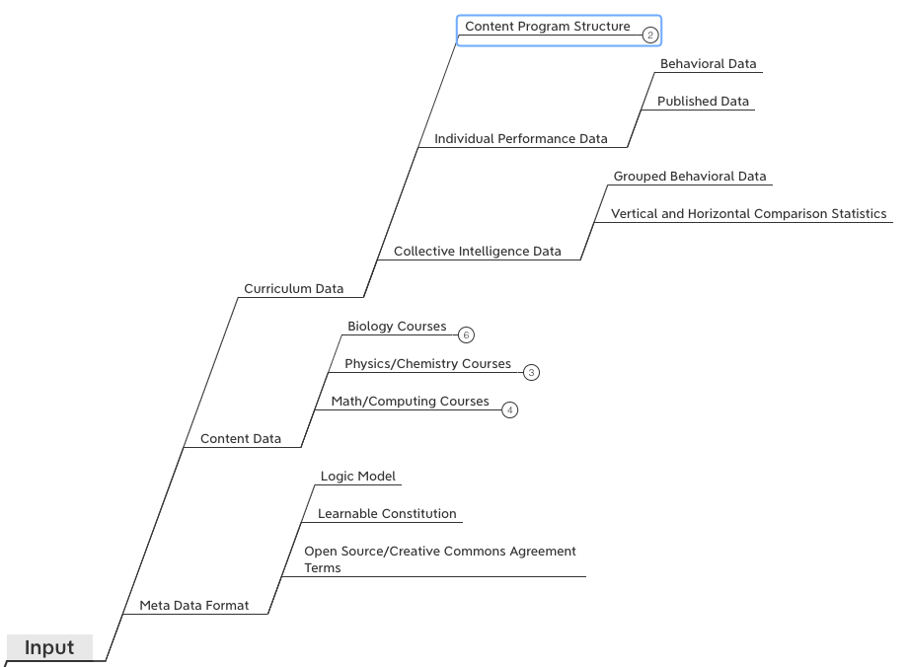
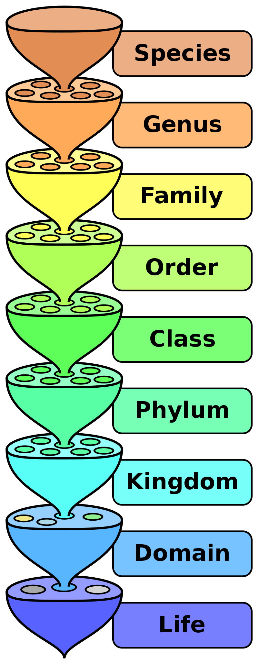

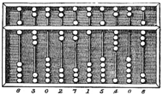
Inputs for Collective Cognizance
A domain-independent knowledge model (curriculum data) for
learning organizations with data collection tools and
statistical data analysis practices (namespace management)
Knowledge Content Data such as
Biology, Physics/Chemistry, Math/Computing
To be taught in ”schools”.
A consistent format to be shared by all content
publishers in the community.

Slide 53
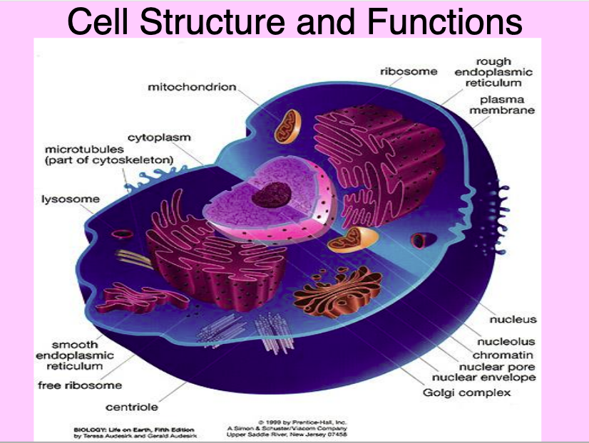
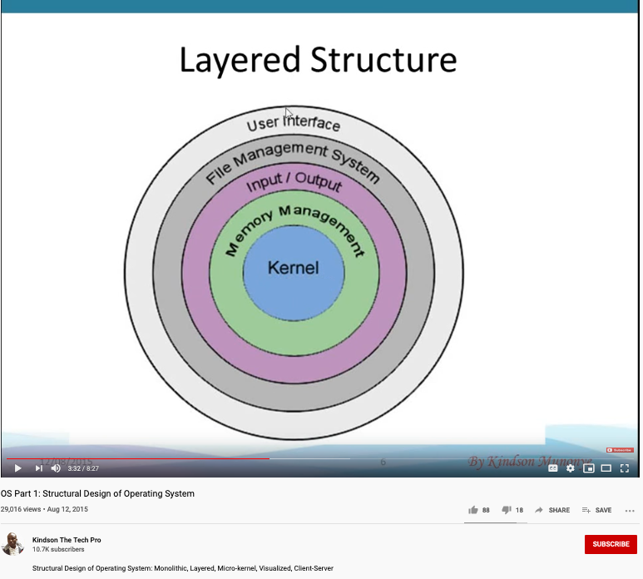
cell structure/functions and operating systems
Image courtesy: Riyaz Hyder on Botmetric November 2, 2017

Slide 54
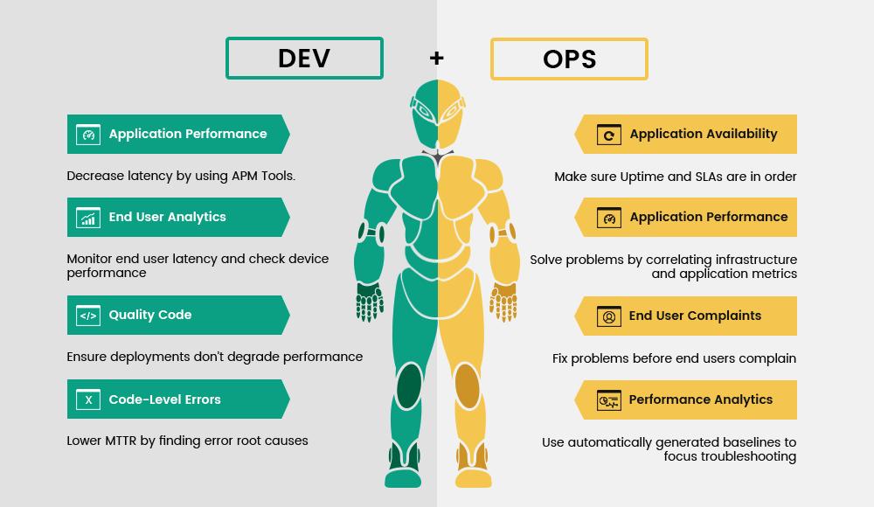
A metaphorical connection between anatomy and application development process
Image courtesy: Riyaz Hyder on Botmetric November 2, 2017

Slide 55

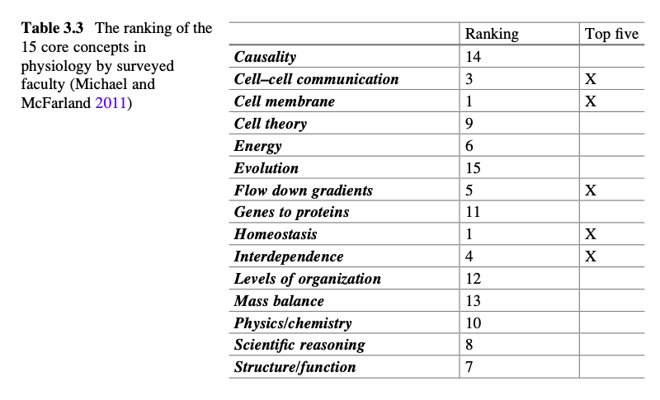
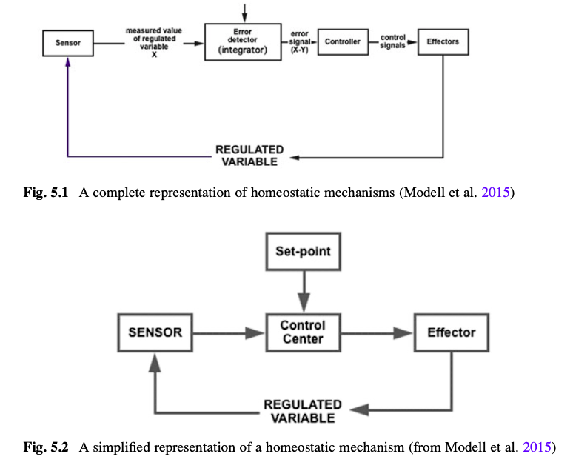
Use Physiology as a Domain-Specific Example
Image courtesy: Riyaz Hyder on Botmetric November 2, 2017

Slide 56

Prof. Elkhonon Goldberg and the Happy Digital X Project of THU

Slide 57



A metaphorical connection between biology and social sciences

Slide 58

Ricardian Contract Socially Binding Digital Twin

Slide 59


Human Physiology and Modern Data Infrastructures Checks and Balances
Data Plane
Control Plane
Data Plane
Control Plane

Slide 60



Code is Law

Slide 61

Spacetime Representations for a Collective Conscious
Far
Space
near
before Time after

Slide 62
Kuhn Cycle as a half cycle of DevOps
Normal Operations
Drifting Norms
Operational Crisis
User Revolution
Version Upgrade
Emerging cases or
systematic attacks

Slide 63



A linguistic approach to Transdisciplinary Cognitive foundation

Slide 64

A Smart way to Govern Activities in Space-Time
Transform everything into Data
(Namespace Management)
Ongoing Development
RICH 70 Tsinghua SEA Cloud Forum, Sep 14, 2020
H. E. Bambang Brodjonegoro,
Minister of Research & Technology, Indonesia
Image credits: http://verses.io

Slide 65



Time sensitive data sources
https://news.ycombinator.com/
Image courtesy: Riyaz Hyder on Botmetric November 2, 2017

Slide 66
GitOps: Git as the Single Source of Truth

Slide 67




Proofing Correctness across time scales

Slide 68





Prior Publications by relevant Course Series
Hyperlinks
between
Documents
Digital Asset
Backup/
Tracking/
Exchange

Slide 69




An Open Source Tech in the Making
Library of
Linked Knowledge
(Data Plane)
Library of Executable Algorithms
(Control Plane)

Slide 70

Representing Collective Consciousness based on the Principe of Information Symmetry
Public Domain Data
Contractual Data
Private
Data
Sec
Dev
Ops
Spiritual
Ecological
People
“Language is an organ of perception, not simply a means of communication”
― Julian Jaynes

Slide 71



An example of Namespace Management

Slide 72


The CAP Theorem in NsM
RICH 70 Tsinghua SEA Cloud Forum, Sep 14, 2020
H. E. Bambang Brodjonegoro,
Minister of Research & Technology, Indonesia

Slide 73



Name Spaces in Databases
RICH 70 Tsinghua SEA Cloud Forum, Sep 14, 2020
H. E. Bambang Brodjonegoro,
Minister of Research & Technology, Indonesia

Slide 74


Quiz: Our Cognitive Strategy stands on what 3 things?
Sec
Dev
Ops

Slide 75
Our Cognitive Strategy stands on three legs
Sec
Dev
Ops
A Method based on
Linguistic Theory (name management)
A Tool Stack based on
Continuous Integration and Git/Wiki
Applications driven by available data sources,
organized by a domain-independent namespace.

Slide 76

Potential Barriers

Slide 77
Content Themes for the semester
Overview (Today)
Namespace Management
Biology, Physics, Math, Code is Law, and Society
Story Telling, Functions/Metaphors/Analogies
Writing, Accounting, Historical Data and Temporal Reasoning
Knowledge Representation in Wiki and Files
Recursion and Continuation (DevOps/CICD)
Midterm Report
Cybernetics (Control and Communication)
Smart City and Internet of Things
Artificial Intelligence and its Social Impacts
Arts/Skills/Human Talents in the Digital Era
Student proposed Application Topics
Rehearsal
Final Reports and Celebration

Slide 78
Students Actions before Wednesday Sep 16
Register on toyhouse.wiki:81 with an account
Create a personal page with bio
Create a link in the personal page to your weekly learning report
Learn to use Mediawiki’s Template, and Category features (use the Logic Model template)
Start writing your learning report.
Every week should include Logic Model
500 words or more per week

